Slide 1

Computer Networking Advanced
Course Introduction
SoftUni Team
Technical Trainers
Software University
http://softuni.bg

Slide 2
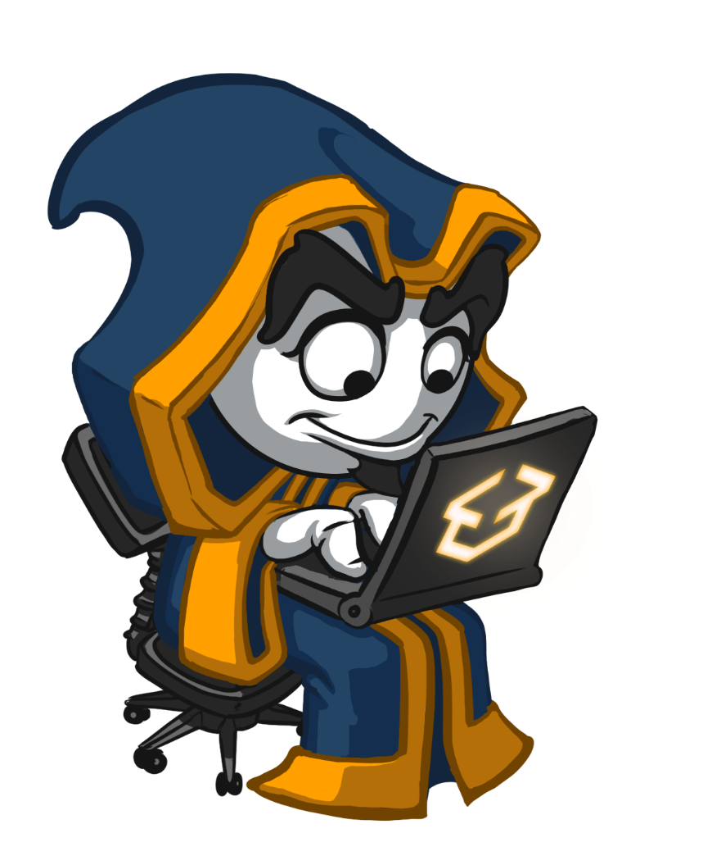
Table of Contents
Course Objectives
Course Program
Trainers Team
Course Schedule
Exams and Evaluation
Learning Resources

Slide 3
Questions
sli.do #NetAdvanced

Slide 4

Computer Networking Advanced
Course Objectives & Program

Slide 5
Computer Networking Advanced – agenda
Session | Title | Date and time
1 | Layer 2 technologies advanced | 04.12; 19:00 - 22:00
2 | Routing – OSPF advanced | 11.12; 19:00 - 22:00
3 | Access Control Lists, Network Address Translation | 18.12; 19:00 - 22:00
4 | Domain Name System, IPv6 | 04.01; 19:00 - 22:00
5 | Advanced authentication with 802.1X, Wireless networking concepts | 08.01; 19:00 - 22:00
6 | Quality of Service, Port mirroring | 15.01; 19:00 - 22:00
7 | Virtualization and networking | 22.01; 19:00 - 22:00
8 | Software Defined Networking – part 1 | 29.01; 19:00 - 22:00
9 | Software Defined Networking – part 2 | 05.02; 19:00 - 22:00
10 | Course summary and preparation for exam | 12.02; 19:00 - 22:00
Exam 1 | Exam | 17.02; 09:00 - 12:00
Exam 2 | Retake Exam | 24.02; 09:00 - 12:00

Slide 6

The Trainers Team

Slide 7
Trainers Team
Vasil Yordanov
13+ years experience in IT
Consultant and trainer for networking, cloud and security
Technical Trainer @SoftUni

Slide 8

Computer Networking Advanced: More Details
Duration, Languages, Technologies

Slide 9

Training Duration – Computer Networking Advanced
Lessons and exercises: 24 hours (onsite + videos)
Exam preparation: All the time ☺
Exam: ≈3 hours
Schedule: Dec 2018 – Feb 2019
Exam date: 17 February 2018
Retake Exam: 24 February 2018

Slide 10

Why English?
Why the slides are in English?
English is the native language of the software engineers
Specific terminology should be in English
Translations are inaccurate and funny
Just learn English!
No excuses!

Slide 11

Computer Networking Advanced
Evaluation Criteria

Slide 12

Scoring System for Computer Networking Advanced
The exam will have two parts:
Practical - you have to configure on your network simulator
Theoretical - this will be a standard test
something
Practice
Test
65%
EVALUATION
CRITERIA
35%

Slide 13

Resources
What We Need Additionally?

Slide 14


Computer Networking Fundamentals Web Site and FB Group
Official web site:
Official Facebook group:
https://softuni.bg/trainings/2136/computer-networking-advanced-december-2018
https://www.facebook.com/groups/SoftUniComputerNetworkingAdvancedDecember2018/

Slide 15

Computer Networking Fundamentals Slides and Videos
All lecture slides, videos, homework assignments, projects and other resources are open content, available for free
Visit the course website to access the course resources

Slide 16

Software University Learning System (SULS)
Software University Learning System (SULS)
www.softuni.bg
Important resource for students
Homework submissions
Homework check-up
Exams and results
Reports about your progress

Slide 17
Requirements for the exercises
Each student must install the latest version of Cisco Packet Tracer
Requirements:
Supported Operating Systems: Microsoft Windows 7, 8.1, 10, Ubuntu Linux 14.04 64 bit
CPU: Intel Pentium 4, 2.53 GHz or equivalent
RAM: 512 MB Free
Storage: 400 MB of free disk space
Display resolution: 800 x 600
Adobe Flash Player
Language fonts supporting Unicode encoding (if viewing in languages other than English)
Latest video card drivers and operating system updates

Slide 18

Summary
…
…
…
Training program
Learning networking concepts with theory, practice, demonstrations, LABs, homework and discussions
Practical exam
Practice plus test
Learning resources
Slides, videos, Packet Tracer, Facebook group, SLI.DO

Slide 20
Diamond Partners

Slide 21
Diamond Partners

Slide 22

License
This course (slides, examples, demos, videos, homework, etc.) is licensed under the "Creative Commons Attribution-NonCommercial-ShareAlike 4.0 International" license

Slide 23





Trainings @ Software University (SoftUni)
Software University – High-Quality Education, Profession and Job for Software Developers
softuni.bg
Software University Foundation
http://softuni.foundation/
Software University @ Facebook
facebook.com/SoftwareUniversity
Software University Forums
forum.softuni.bg

